Slide 1
Mobile and Embedded Platform Security
Elena Reshetova

Slide 2
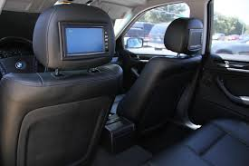

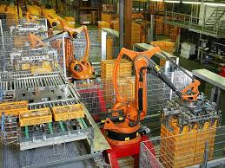


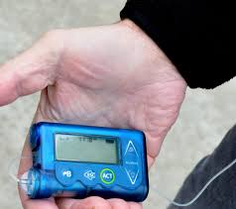
Mobile and embedded devices around us
In-Vehicle entertainment
Personal devices
Building automation
Environment controls & drones
Smart Home systems
Healthcare devices

Slide 3
But attacks against them are pervasive

Slide 4
Why platform security?
“… encryption on the Internet is like arranging an armored car to deliver credit card information from someone living in a cardboard box to someone living on a park bench” - attributed to Gene Spafford

Slide 5



What is platform security?
Protection mechanisms
Access
Control
Mobile
or
Embedded device
Integrity
Protection
Root
Of
Trust
Isolation
Adversary
Security HW
Key
management
OS Kernel
Security
Crypto
APIs
$$PI$$
Old, new, borrowed, blue: a perspective on the evolution of mobile platform security architectures

Slide 6





Contribution of this dissertation
Access
Control
$$P II$$
Characterizing SEAndroid Policies in the Wild
$$P III$$
SELint: an SEAndroid policy analysis tool
Isolation
$$P IV$$
Security of OS-Level Virtualization Technologies
OS Kernel
Security
$$P V$$
Randomization Can't Stop BPF JIT Spray
$$P VI$$
Towards Linux Kernel Memory Safety

Slide 7
Desiderata for security mechanisms
Security
Practical deployability
Usability
Main focus
Ease of integration
Scalability
Performance
End users
Developers
…

Slide 8


Isolation & access control
Well-behaving application
Malware
Media viewer
Cool new game
Access Control
Camera app
Isolation

Slide 9

SEAndroid Access Control for Lollipop 5.0
$$P II$$
Desktop access control system SELinux → SEAndroid
Primary change is the Access Control Policy
SEAndroid is mandatory → OEMs have to create proper policies
Our study showed that many common mistakes and flaws exist
OEMs can benefit from more sophisticated, Android-aware tools

Slide 10


Towards better SEAndroid policies
$$P II$$
$$P III$$
Two new Android-aware tools
SEAL
Matches policy and runtime device state
Usability: works using standard Android debug interface
Deployability: easy to combine with other tools
SELint
Helps avoiding common mistakes
Usability: integrates into OEM’s development cycle
Deployability: extensible and flexible framework, acceptable performance
SELint architecture
github.com/seandroid-analytics

Slide 11
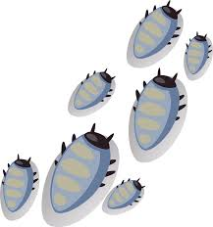
OS Kernel hardening - Bugs
Linux kernel exploits are built using programming mistakes (bugs):
Stack overflow
Format strings
Temporal memory errors
Spatial memory errors
…

Slide 12



OS Kernel hardening – Possible approaches
Prevent bugs from happening
Reference counters
overflow protection
$$P VI$$
Prevent triggering the bugs
$$P VI$$
MPXK mechanism
Prevent bugs from being exploited
$$P V$$
BPF JIT Compiler hardening
Detect intrusion and react appropriately

Slide 13

Memory safety for Linux kernel
$$P VI$$
Memory Safety
Temporal Memory Safety
Spatial Memory Safety
Dereferencing a pointer to freed/uninitialized memory | Reason | Use a pointer to access memory outside of its allocated bounds
reference counters overflows | Occurrence in Linux kernel | General out of bounds accesses
New reference-counter specific type and API | Proposed mechanism | MPXK, adaptation of MPX for in-kernel use
Overflows are not possible for new type | Security guarantee | Ensures spatial memory safety for objects with known bounds
Gradual conversion to the new type, ~70% of core Linux kernel converted | Deployability considerations | Per-subsystem/compilation unit protection
Must fit typical reference counter patterns found in Linux kernel | Usability considerations | Must be easy to enable in a standalone subsystem

Slide 14
Future outlook
Mobile platform security
Gradual development
MAC mechanisms
OS kernel hardening
Embedded devices platform security
Major focus & development area
OS kernel hardening
Decentralized aspects of IoT
New security challenges:
Easy device discovery, interoperability, semantic search, …
HW attacks on CPU & other parts
Current examples:
Rowhammer, Spectre, Meltdown, Foreshadow, …

